Slide 1
Packets in Flight
CS 168 – Spring 2020 – Section 1
Feedback: tiny.cc/Ians168Discussion

Slide 2
whoami: Ian Rodney
4th year EECS Major
From San Diego
I like Networking, Systems & Security
Hobbies:
Hiking
Autocrossing/Racing
Photography
Going to SF too much (aka traveling)
Cal...Go Bears (aka Rally Comm)

Slide 3
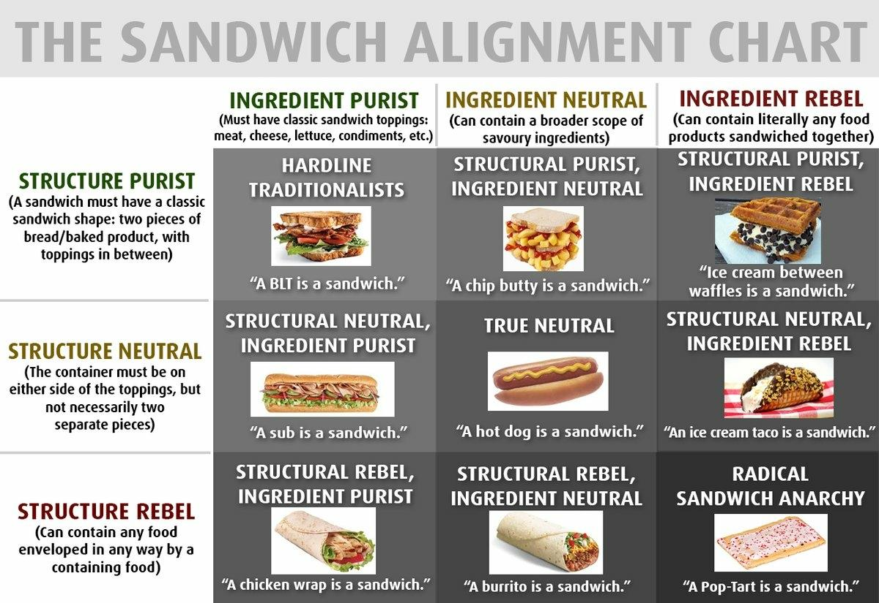
Ice Breaker (fa18 redux)
Notes:
(~5 minutes)
Name, Sandwich Alignment Chart, Why did you take 168?

Slide 4
Delays
How long does it take for your data to reach its destination?
It depends on…
your distance from the destination → propagation delay
how much data you’re sending and the link speed → transmission delay
the traffic pattern → queuing delay
how fast routers process the packet header → processing delay
Notes:
Transmission – how long it takes computer to actually put bits onto the wire. Depends on how much data you’re sending and the link speed
Propagation – normally speed of light.
Queueing – the traffic pattern. Routers are usually receiving/sending many packets on many different connections simultaneously, and this can slow down the network.

Slide 5
Delays
How long does it take for your data to reach its destination?
It depends on…
your distance from the destination → propagation delay
how much data you’re sending and the link speed → transmission delay
the traffic pattern → queuing delay
how fast routers process the packet header → processing delay
Notes:
Not gonna cover it

Slide 6
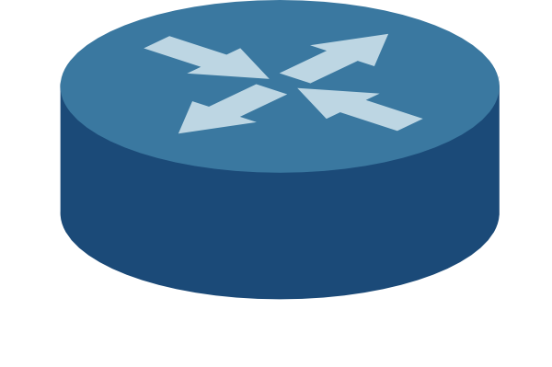

Propagation Delay (latency)
End-to-end transmission time of one bit
Depends on the length of the link
Limited by the speed of light (propagation speed of link)
Does NOT depend on the size of the packet
Notes:
Technically it is the speed of light in whatever material the signal is going through

Slide 7

Propagation Delay: Formula

Slide 8

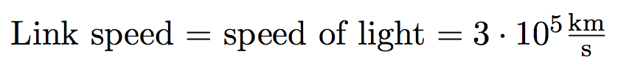
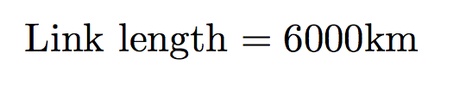
Propagation Delay: Example
Notes:
New york to Amsterdam

Slide 9
Transmission Delay
How long it takes for the all bits in the packet to get on the wire
The time between when the first and last bits enter the link
Notes:
Pouring a bucket of water into a tube
--how long for the bucket to become completely empty

Slide 10
Transmission Delay
How long it takes for the all bits in the packet to get on the wire
The time between when the first and last bits enter the link
Limited by the bandwidth
Notes:
Bandwidth – how many bits you can send through a wire per second

Slide 11
Transmission Delay
How long it takes for the all bits in the packet to get on the wire
The time between when the first and last bits enter the link
Limited by the bandwidth
Function of packet size
Notes:
Transmission delay depends on packet size: the more data you have to send, the longer it’s gonna take to put that data onto the wire. You can only put so many bits onto the wire per second

Slide 12
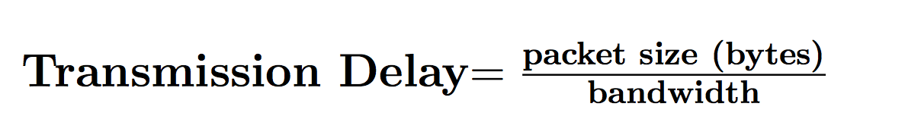
Transmission Delay
Usually bits/second
Notes:
Transmission delay depends on packet size: the more data you have to send, the longer it’s gonna take to put that data onto the wire. You can only put so many bits onto the wire per second

Slide 13
Transmission Delay: Example
Bandwidth = 4 Mbps
Packet size = 500B

Slide 14
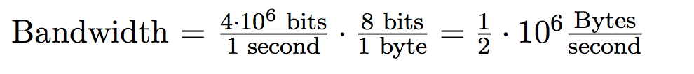
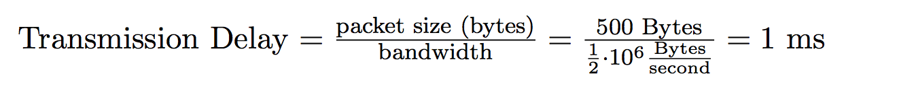
Transmission Delay: Example
Why did we have to do this?
1 byte
8 bits
Bandwidth = 4 Mbps
Packet size = 500B

Slide 15
Bandwidth Delay Product (BDP)
Now that we know the propagation delay, we can tell how many bits are “in flight” (on the link) at any time
??
??
BDP = ?? * ??

Slide 16
Bandwidth Delay Product (BDP)
Now that we know the propagation delay, we can tell how many bits are “in flight” (on the link) at any time
Bandwidth
Propagation delay
Notes:
bytes/second * seconds = BYTES

Slide 17
Packets might have to wait before they can be transmitted…

Slide 18
Queuing Delay
How long the packet waits to get transmitted on the wire
Happens only when arrival rate is greater than transmission rate
Notes:
(cute animation of packets queueing on click)

Slide 19
An easy fix for queuing delay?
Naïve solution: max(arrival rate, transmission rate)
Is this sufficient?
Notes:
I’m not sure what this slide is meant to say

Slide 20
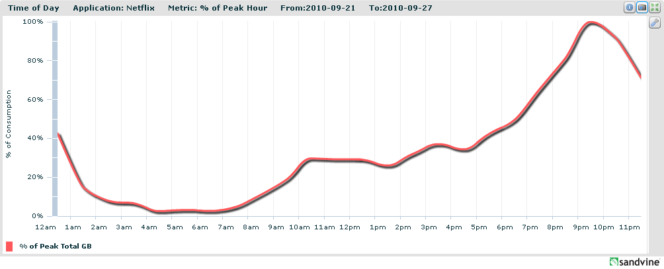
Burstiness!
Transmission rate = constant over time
Arrival rate = not constant over time
Netflix Traffic, circa 2010

Slide 21
Burstiness and Queues
How does burstiness affect queuing delays?
What happens when the queue is full?

Slide 22
Burstiness and Queues
How does burstiness affect queuing delays?
Bursty flows tend to increase queuing delay
What happens when the queue is full?
Packets are dropped

Slide 23


End-to-End Delay
Sum of all nodal delays on the path
End-to-End Delay = Propagation Delay + Transmission Delay + Queuing Delay

Slide 24
Round Trip Time (RTT)
The time it for the packet to reach its destination and receive a response
RTT = 2 * (End-to-End Delay)

Slide 25
Visualizing packet delay…
Time
Transmission delay
Propagation delay
Notes:
Consider Transmission & Propagation Delay on the Receiver’s perspective (vs. Sender’s)
All bits really have the same propogation time

Slide 26
Visualizing packet delay…
Time
Propagation delay
Transmission delay
Notes:
Not quite accurate because Transmission Delay is more of a receive side thing

Slide 27
Visualizing end-to-end delay…
R
B
A
Time
Transmission delay
Propagation delay
Transmission delay
Propagation delay
Notes:
Lower BW, HIGHER BW
NOTE, you must receive full packet before sending the next one

Slide 28
Visualizing end-to-end delay…
Two packets, back-to-back
Time
Transmission delay
Propagation delay
What is this??
End-to-end delay of brown packet
Transmission delay
Propagation delay
Notes:
High BW then Low BW

Slide 29
Visualizing end-to-end delay…
Two packets, back-to-back
Time
Transmission delay
Propagation delay
Queuing delay
End-to-end delay of brown packet
Transmission delay
Propagation delay
Notes:
High BW then Low BW

Slide 30
Questions on Delays?

Slide 31
Statistical Multiplexing
12
Sum of the peaks is always greater than the peak of the sums (peak of the aggregate). Usually much greater.
15
12
9
>
15
36
15
12
15
9
15
9
Notes:
Most important concept in Scott’s Opinion Does anyone remember what it is?

Slide 32
Statistical Multiplexing
12
15
12
9
15
12
15
9
15
9

Slide 33
Discussion Questions
Disclaimer: We will not finish these in section, that is okay
1,2,4,3,5
Notes:
PLEASE pair up

Slide 34
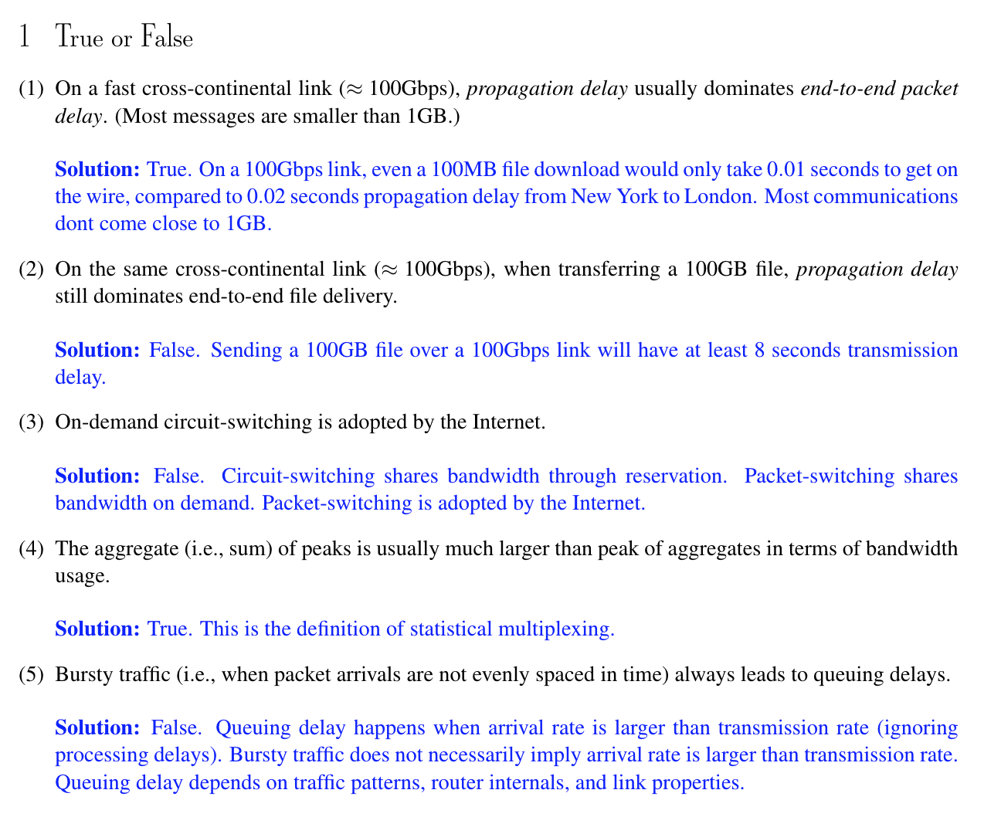
Notes:
Cross Continental is like 6000KM which was 20 ms of delay
Answers show up in animation
True
False
False
True
False

Slide 35
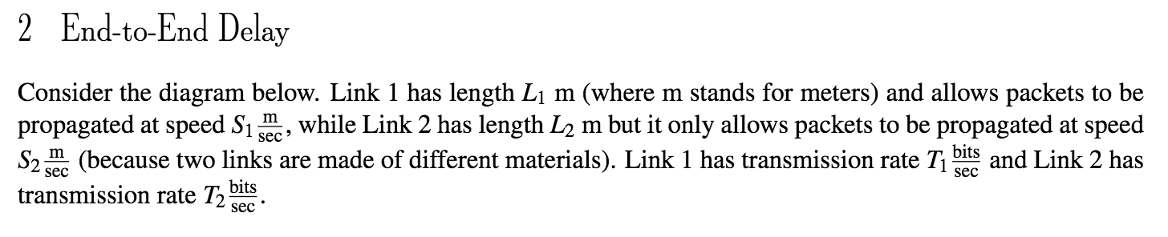
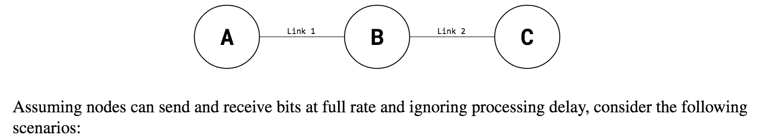
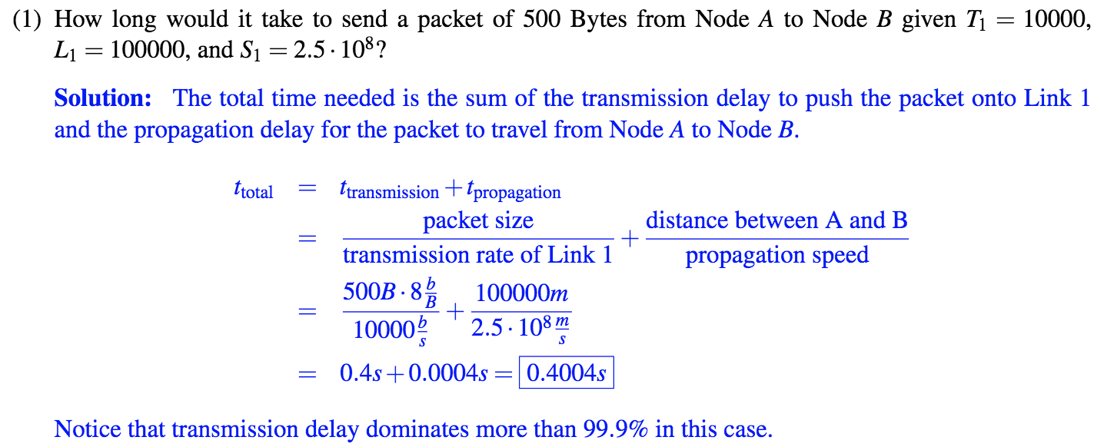
Notes:
Answers show up in animation
Answer = .4004s

Slide 37
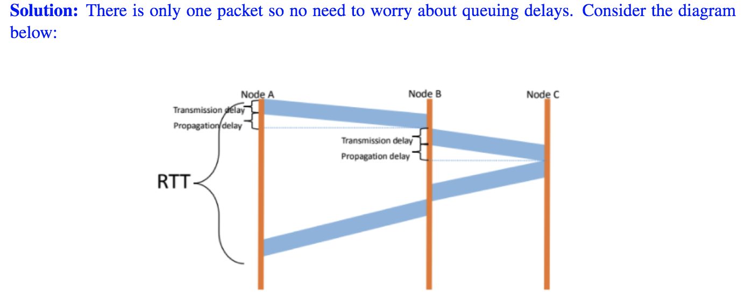
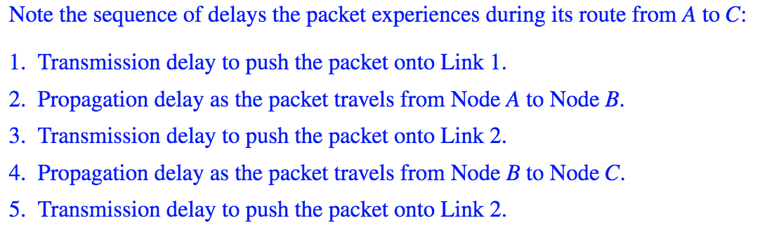
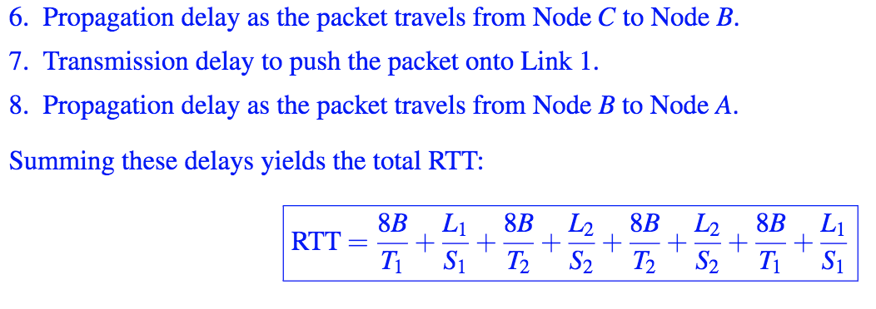

Slide 39
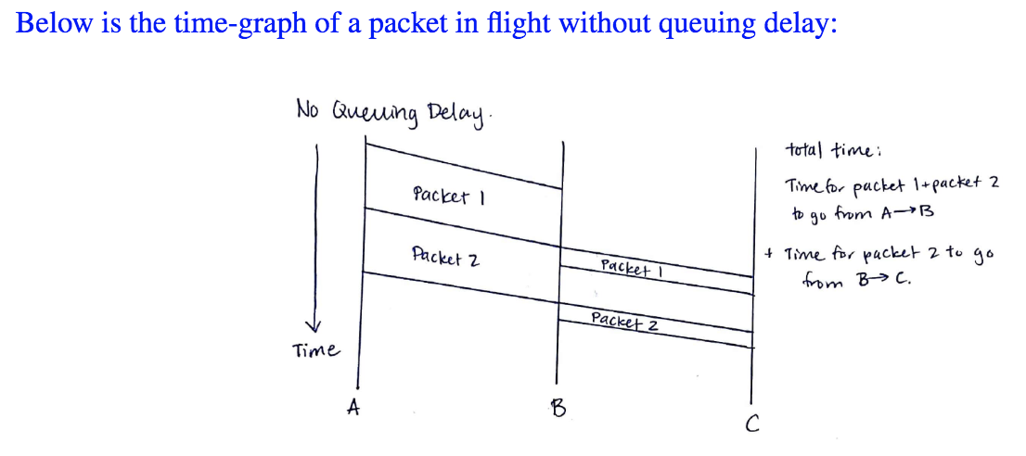
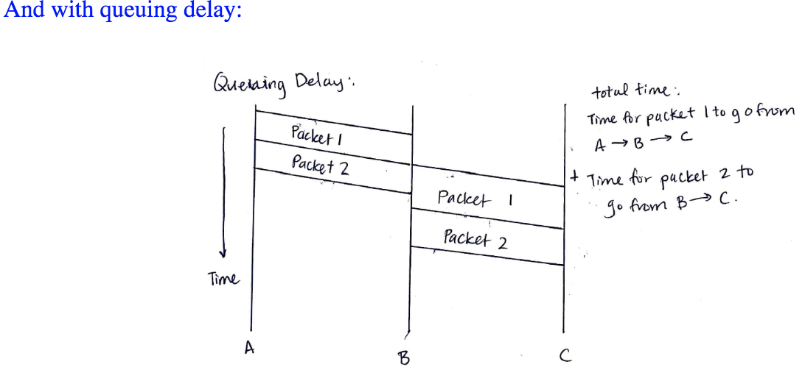
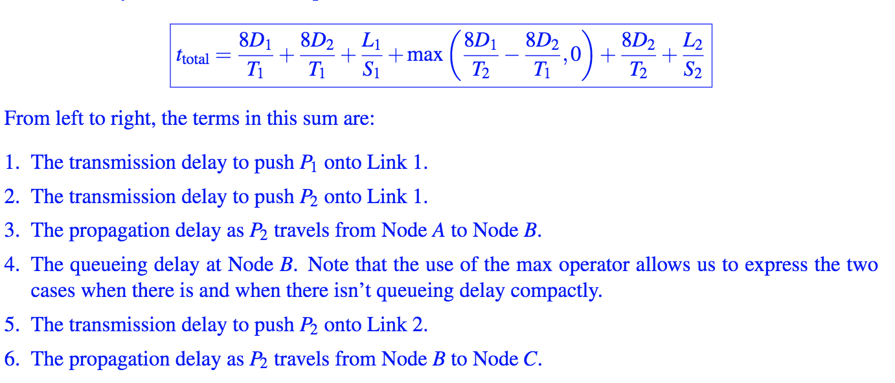

Slide 40
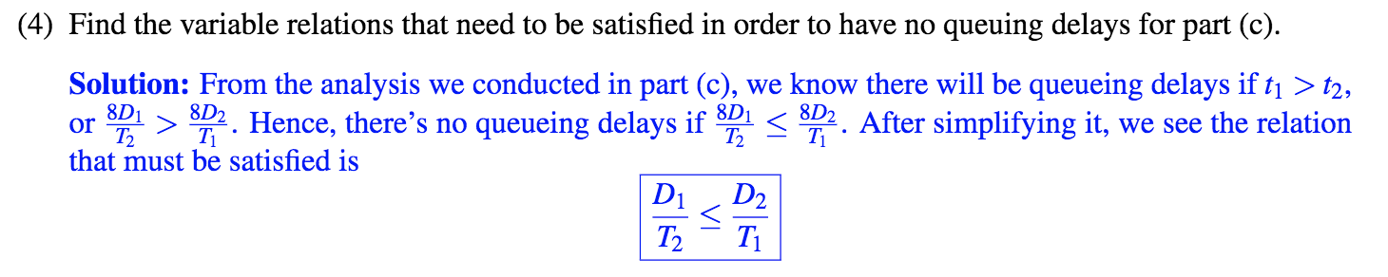
Notes:
Answers show up in animation
D1/T2 <= D2/T1

Slide 41
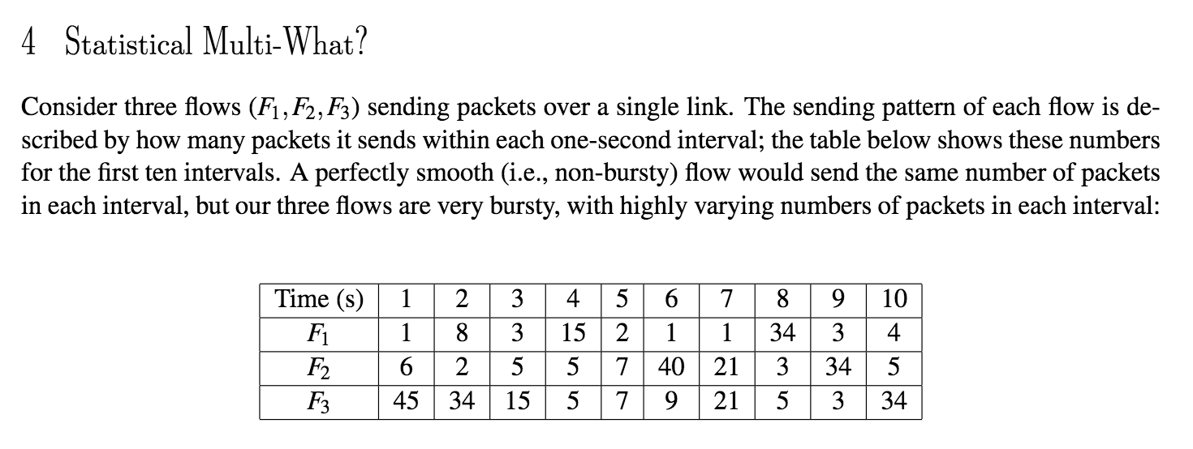
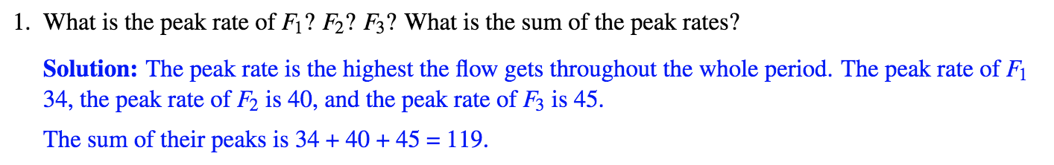
Notes:
Answers show up in animation
Answer: 119

Slide 42
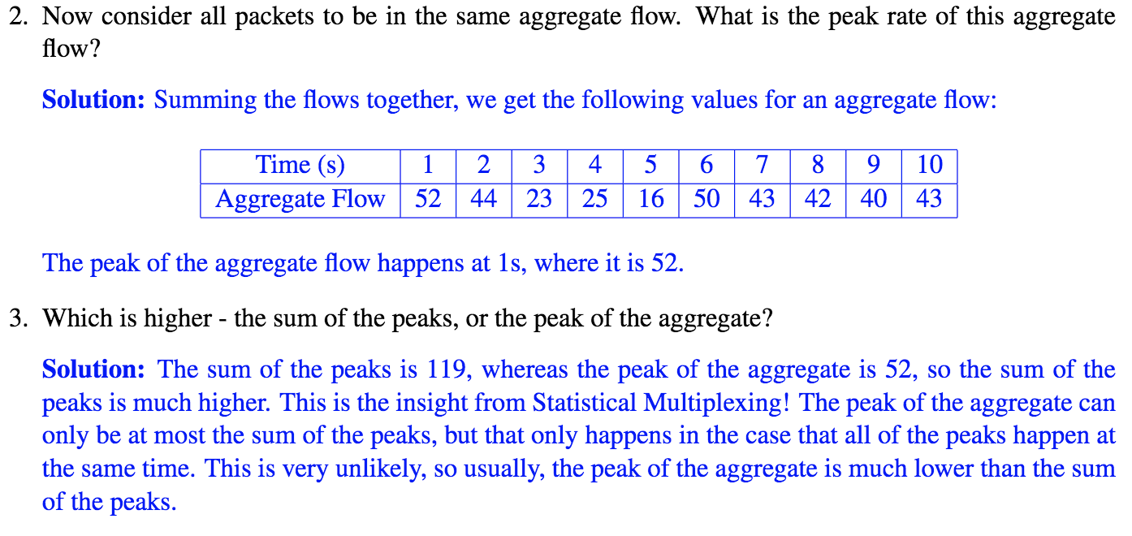
Notes:
Answers show up in animation
Answer: 52
Answer: Sum of the Peaks

Slide 43
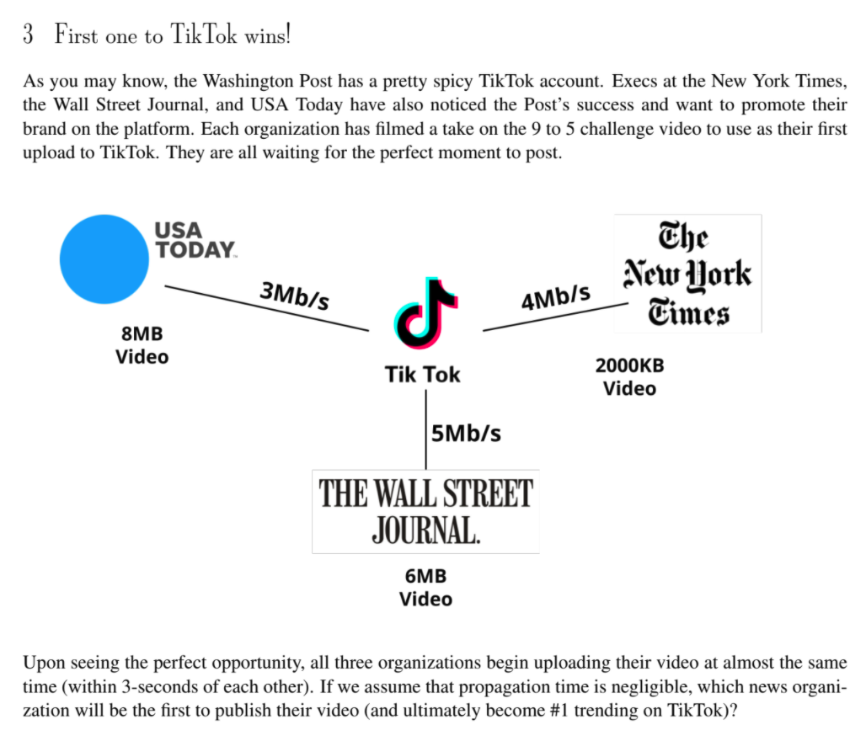
Notes:
Hint: NYTimes wins

Slide 44
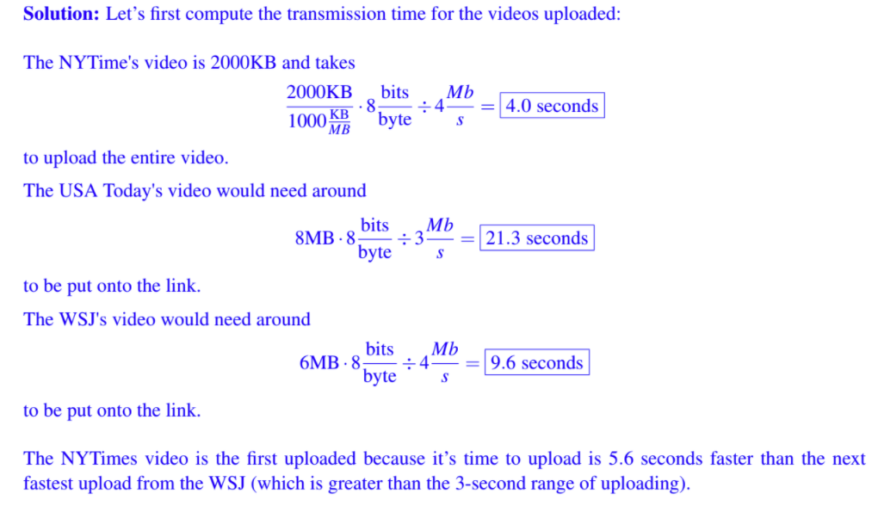

Slide 45
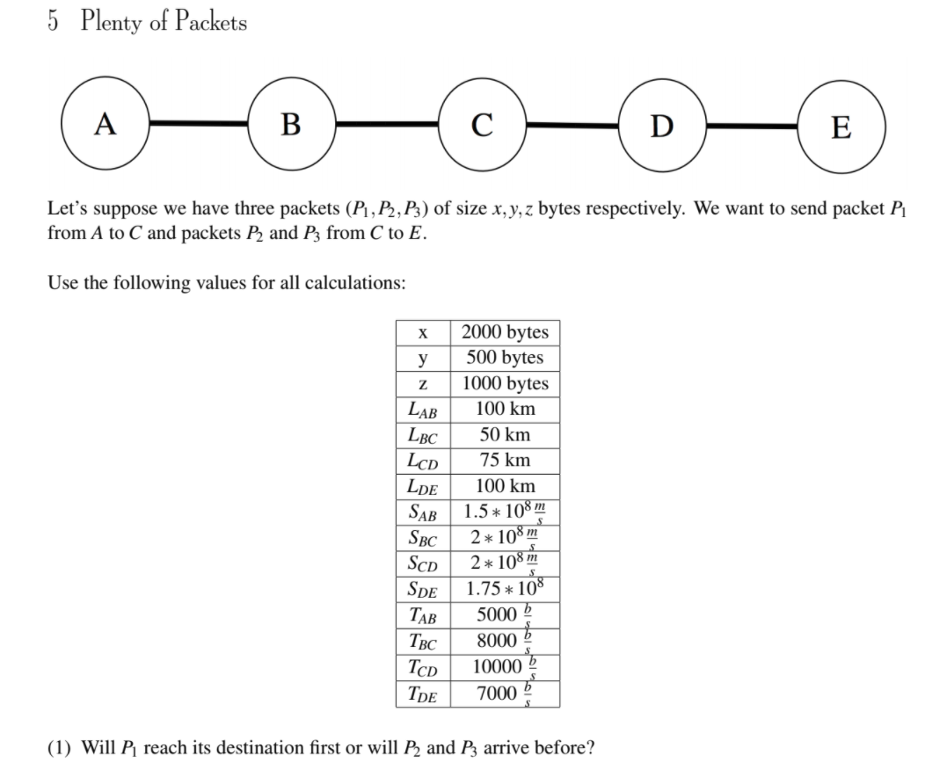

Slide 46
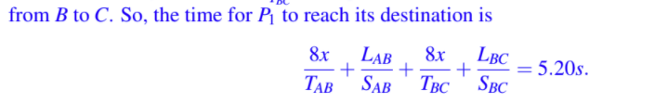
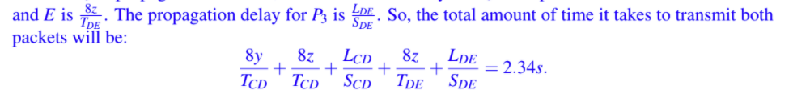


Slide 48
